Slide 1

Optimization of Box Allocation in Meal Kit Delivery
Student: Thi Nguyen
Project sponsor: Mr Loïc Genest
Academic supervisor: Dr Alain Zemkoho
Date: 27th Sep 2024
Notes:
Good morning, my name is Thi, and today I will present my MSc dissertation on 'Optimization of Box Allocation in Meal Kit Delivery.' This project is sponsored by Mr. Loïc Genest and supervised by Dr. Alain Zemkoho.

Slide 2
Contents
Introduction
Methodology
Results and analysis
Limitations and future directions
Notes:
This presentation is structured into 4 parts as shown on the screen. Let’s begin with the introduction.

Slide 3
Contents
Introduction
Methodology
Results and analysis
Limitations and future directions
Notes:
Meal kit delivery service faces the challenge of efficiently allocating recipe boxes to factories.
My project investigates how to optimize this process.

Slide 4
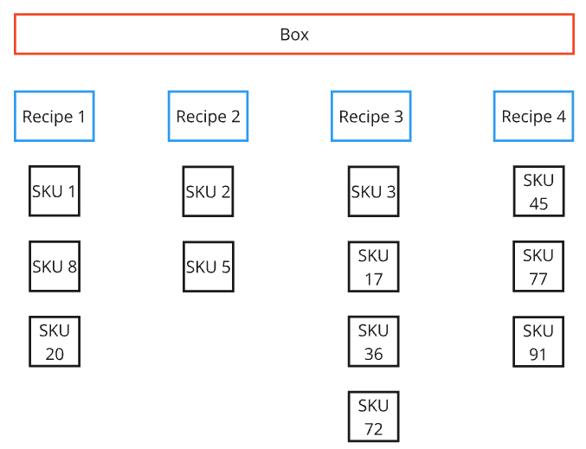
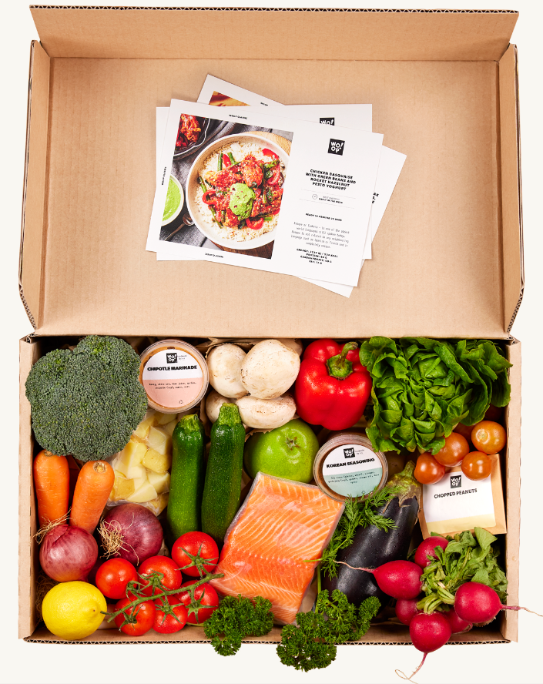
Box structure
Notes:
Before coming to optimization methods, it’s important to know the box structure.
As shown on the screen, each box contains various ingredients or SKUs used to cook different recipes.

Slide 5
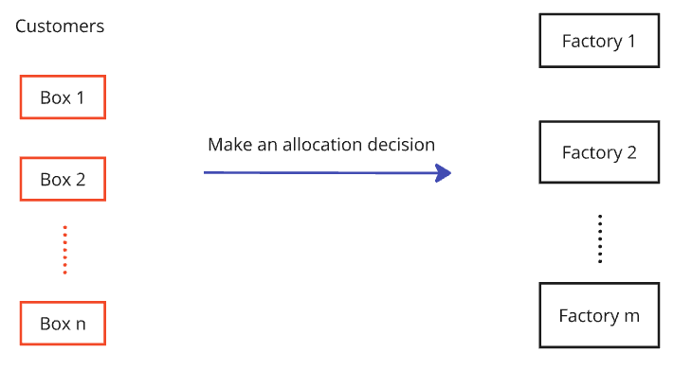
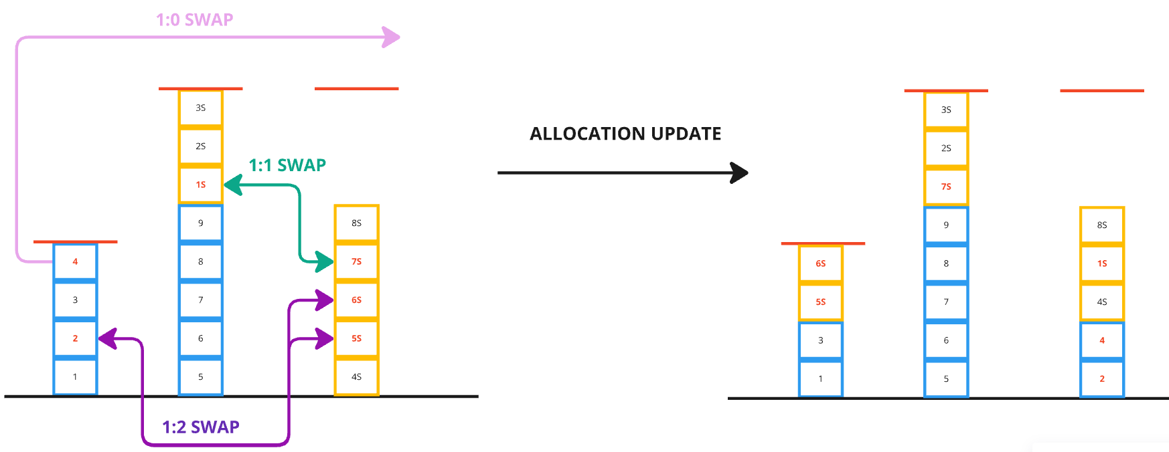
Box allocation problem (BAP)
Twice a day:
2. Optimize allocation decision by swapping orders between factories:
Notes:
In reality, these boxes are allocated to factories twice per day based on 2 constraints explained in the next slide.
An efficient allocation ensures the number of each recipe produced by each factory remains consistent over time, which is measured by WMAPE site.
The heuristics in this dissertation improve the allocation by continuously swapping orders between factories to reduce site error.

Slide 6
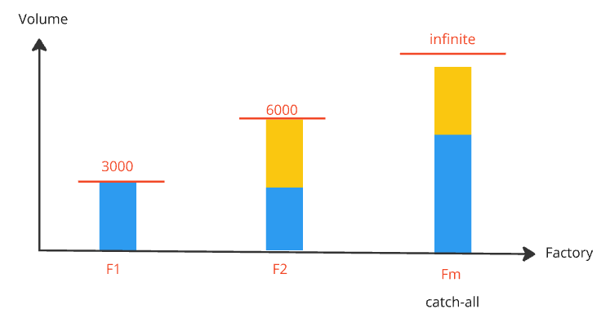
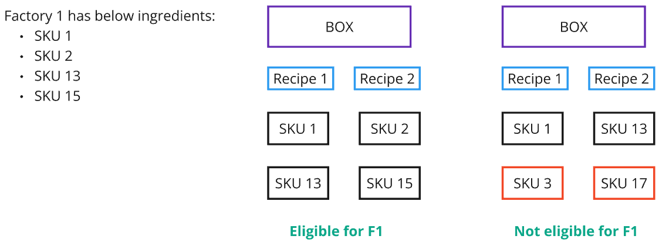
Constraints
Factory full capacity
2. Recipe and SKU eligibility
Notes:
BAP has 2 main constraints:
Factory full capacity: This means except for the catch-all factory, the number of boxes allocated to each factory must fully meet its capacity to avoid wasting resource.
Recipe and SKU eligibility: Because not all factories are equipped to produce every recipe, allocation decision must consider this constraint.
A box can only be assigned to a factory if all recipes or SKU inside it are eligible for that factory.

Slide 7
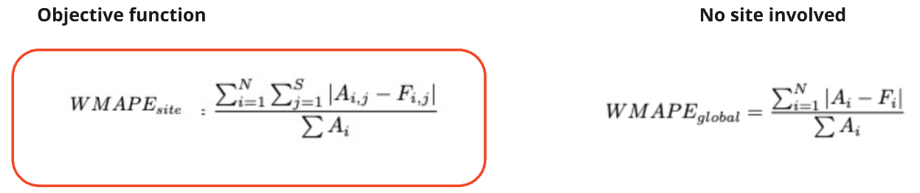
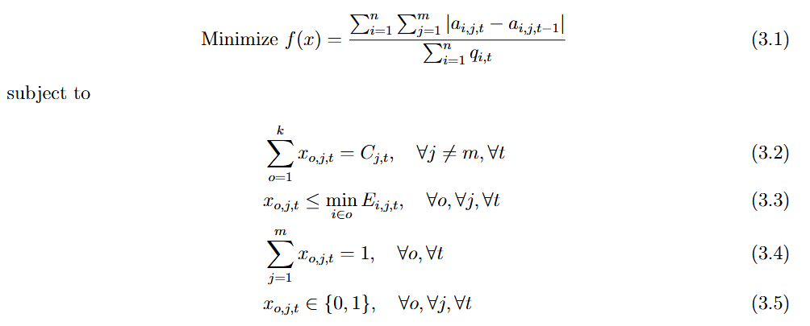
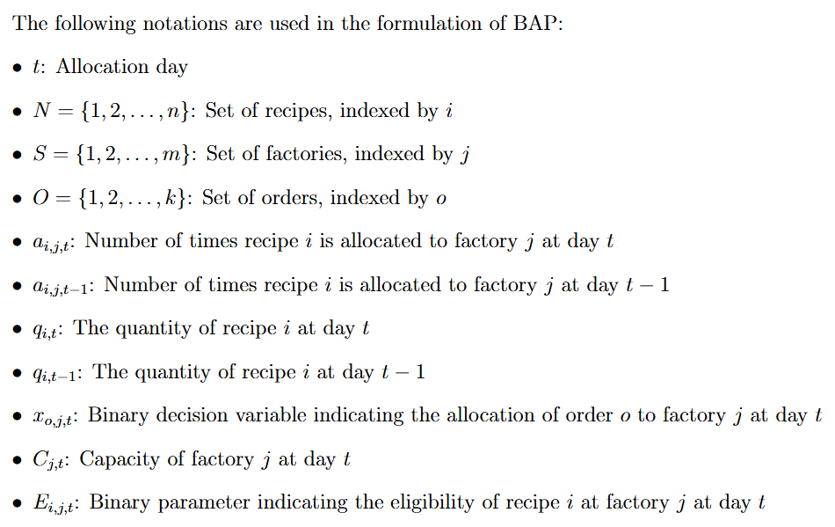
Mathematical model
(Lower bound of WMAPE_{site})
Notes:
Regarding mathematical model, it’s important to distinguish two types of errors.
When all factories (sites) are involved, we have WMAPE site as red highlighted which is the main objective of our model.
When no factories are involved, we have WMAPE global on the right-handed site, which is the lower bound of WMAPE site.
To capture all features of BAP, from the original formula of WMAPE site, I developed a more detailed mathematical model under the arrow.
This model aims to minimize the recipe difference between all consecutive days, while respecting both capacity and eligibility constraints.

Slide 8
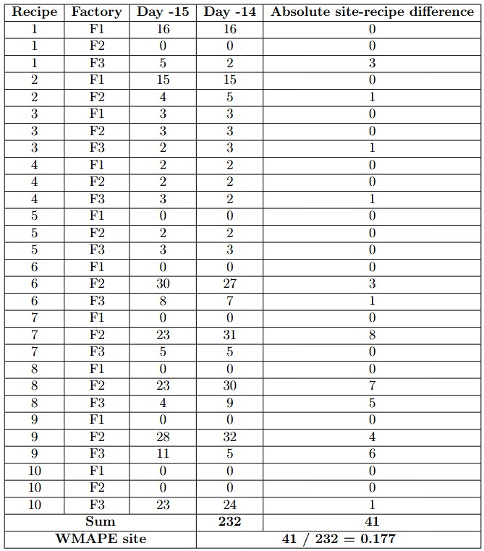
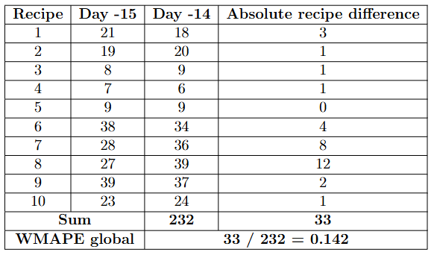
Exemplary WMAPE calculation
Notes:
To illustrate how 2 types of errors are calculated, the above tables are provided.
It can be seen that the global error is lower than the site error.

Slide 9
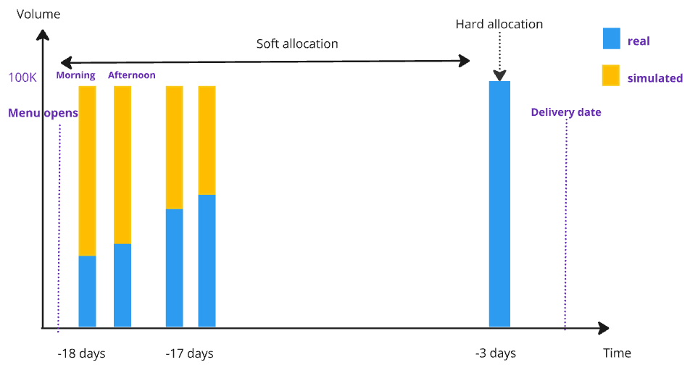
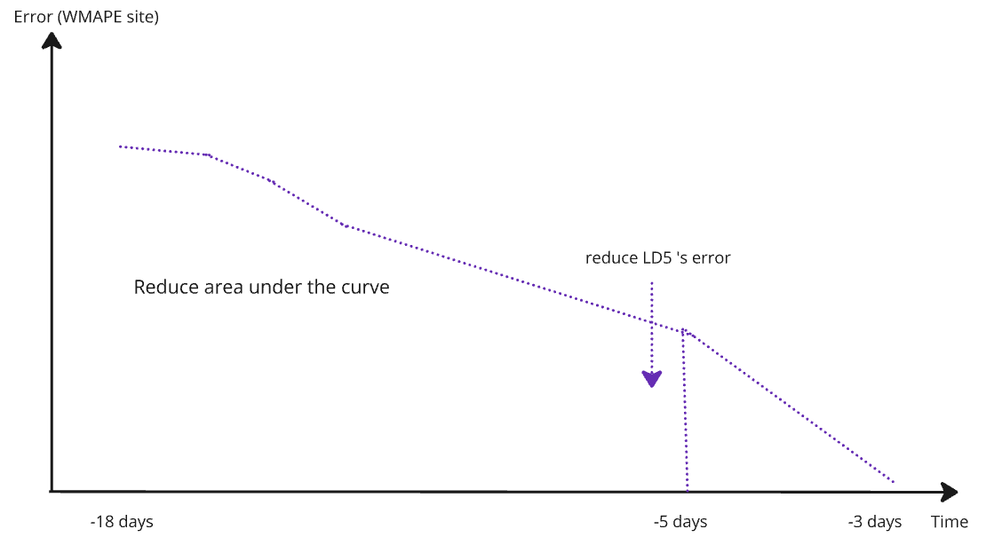
Proxy optimization
Temporal aspect:
2. Ultimate goal:
Notes:
An important feature of BAP is its temporal aspect. We need to decide the best allocation of orders twice per day as the 1st graph. In my dissertation, orders are allocated once per day for simplicity.
This graph also shows that the percentage of real orders increase over time.
All decisions before LD3 are called soft allocation and can be changed while decision for the final day (LD3) is called hard allocation and can’t be changed anymore.
Due to the complexity of directly minimizing errors across the entire planning period measured by the area under the curve in the 2nd graph, we use a proxy optimization approach.
The idea is to minimize site error between consecutive days, which acts as a stand-in for the bigger goal of minimizing errors over the whole period.

Slide 10
Contents
Introduction
Methodology
Results and findings
Limitations and future directions
Notes:
After gaining a general understanding of the targeted problem, we move to the methodology part.

Slide 11
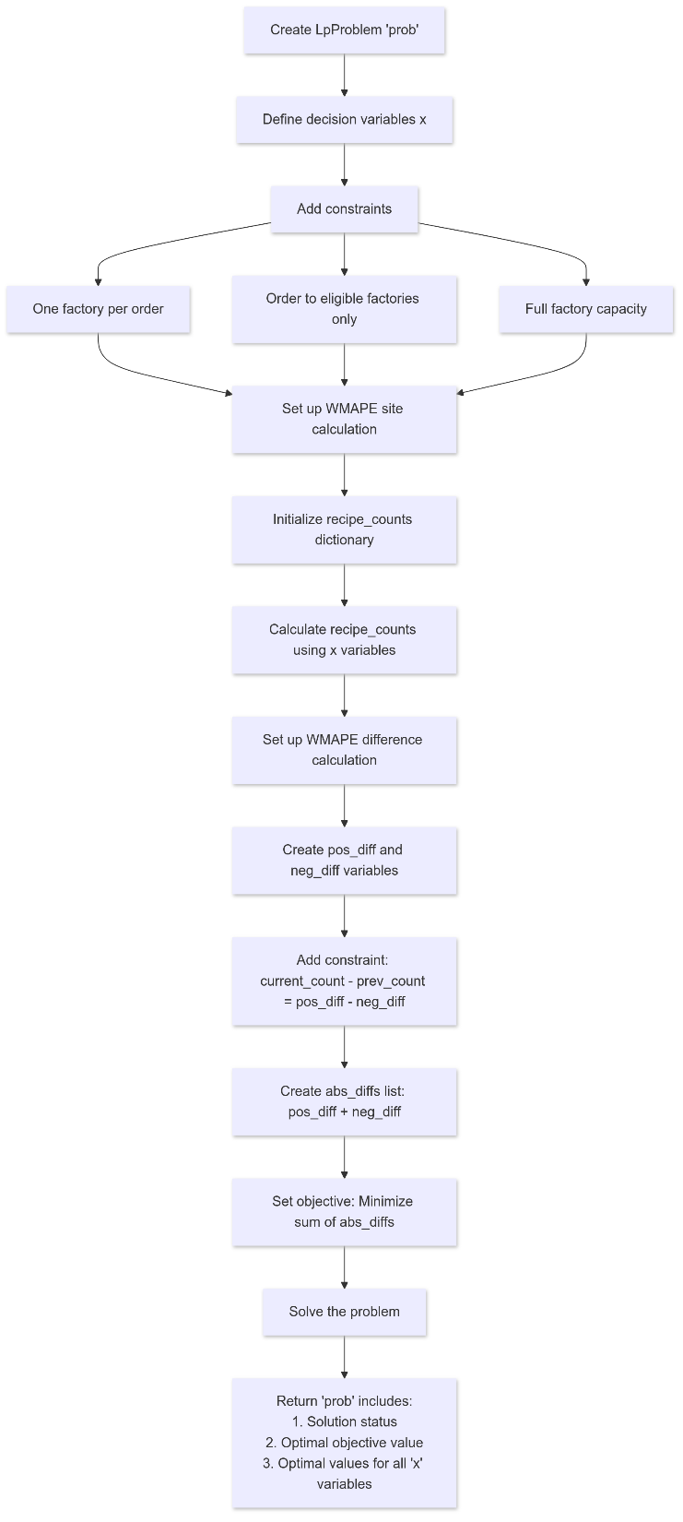
Exact method
CBC (COIN-OR Branch and Cut) solver: B&B with primal heuristics (Feasibility Pump, Coefficient Diving).
Directly allocate current day’s orders based on the previous day’s allocation to minimize WMAPE_{site}.
Notes:
For the exact method, I used the CBC solver which incorporates B&B with two primal heuristics called Feasibility Pump and Coefficient Diving to solve BAP to optimality quickly.
This method directly allocate the current day's orders based on the previous day's allocation to minimize WMAPE site.
The main steps CBC used to solve BAP is shown on the diagram.

Slide 12
Heuristics
Construct an initial feasible solution using a greedy algorithm:
– Eligible orders are first allocated to F1 until fulfilling F1’s capacity.
– Allocate the remaining eligible orders to F2 until its capacity is reached.
– All unallocated orders are assigned to F3 (catch-all factory).
➔ Apply 2 proposed heuristics to improve the initial solution.
Notes:
Regarding heuristics, I designed two algorithms and compare their performances with the exact method.
The starting point of heuristics is to construct a feasible solution using a greedy algorithm with steps explained on the screen.
This helps quickly assign current orders to eligible factories with priority from F1 to F3, providing a foundation to apply improvement heuristics in the next parts.

Slide 13
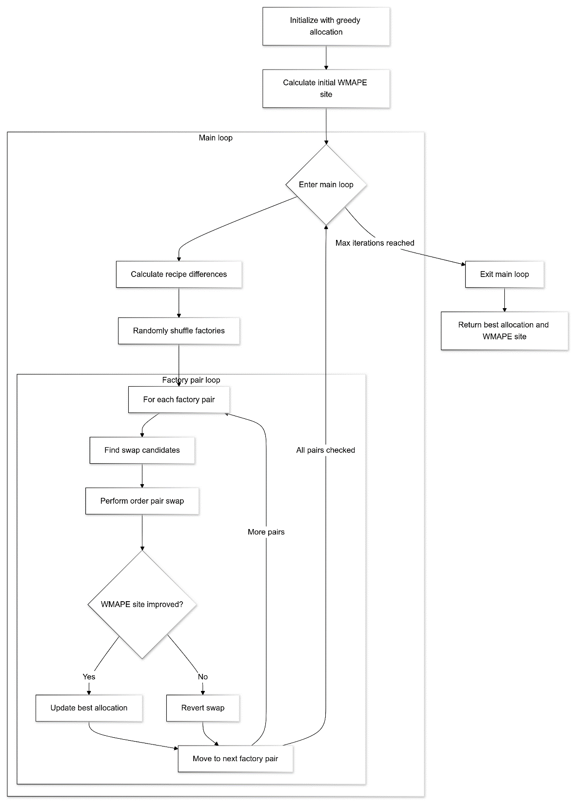
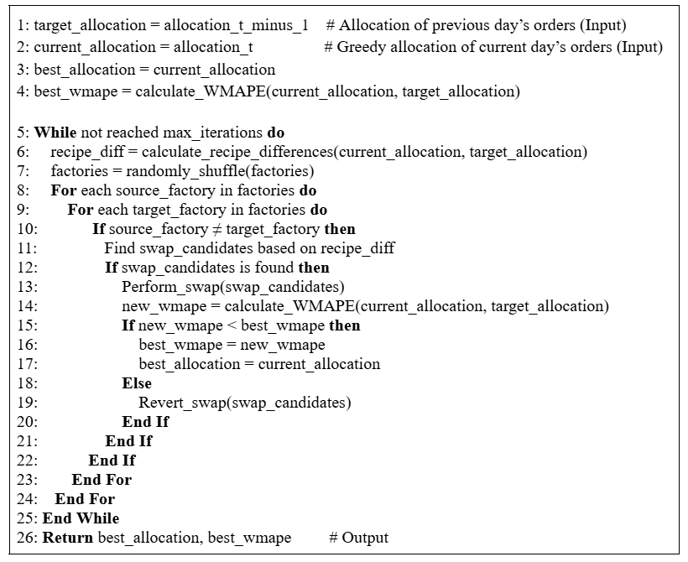
Iterative targeted pairwise swap (ITPS)
Local search heuristic, inspired by 2-opt.
Focuses on pairwise exchanges.
Notes:
The first proposed heuristic is called Iterative Targeted Pairwise Swap.
It is a local search heuristic that swaps two boxes between two factories at one time.
It operates by identifying beneficial swaps and testing whether they can reduce the WMAPE site.
The pseudo code and solving process are shown on the screen.

Slide 14
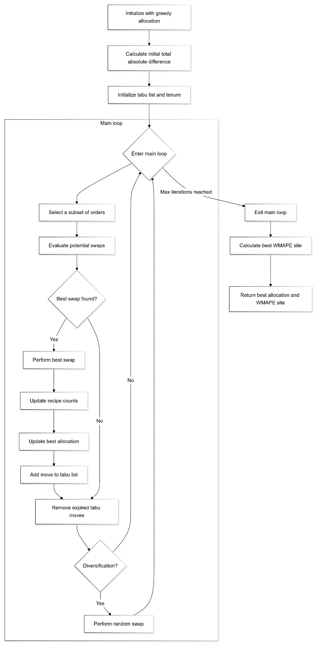
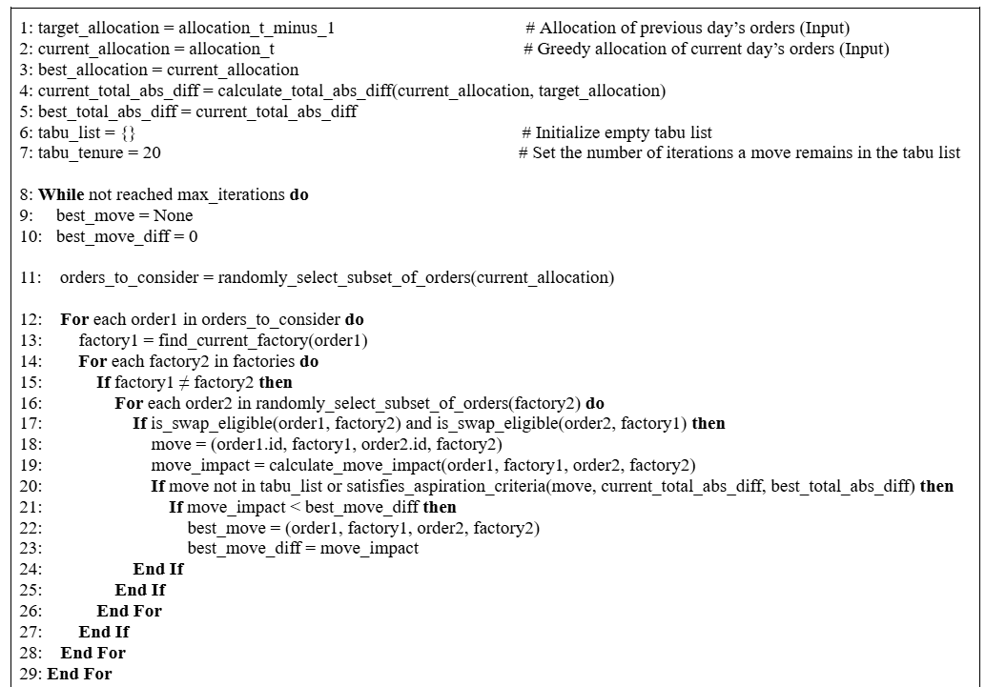
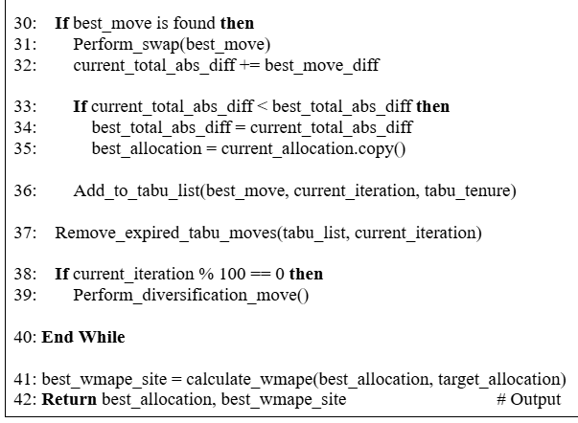
Tabu search (TS)
Metaheuristic
Uses adaptive memory to guide search.
Combines strategic exploitation and exploration.
Notes:
Next is the metaheuristic called Tabu search.
It is a more advanced technique that combines strategic local search with adaptive memory to navigate the solution space.
By tracking previous moves and preventing revisits, TS can avoid suboptimal solutions and find better allocations over time.

Slide 15
Contents
Introduction
Methodology
Results and analysis
Limitations and future directions
Notes:
The above methods are applied on many tests and provide the following results.

Slide 16
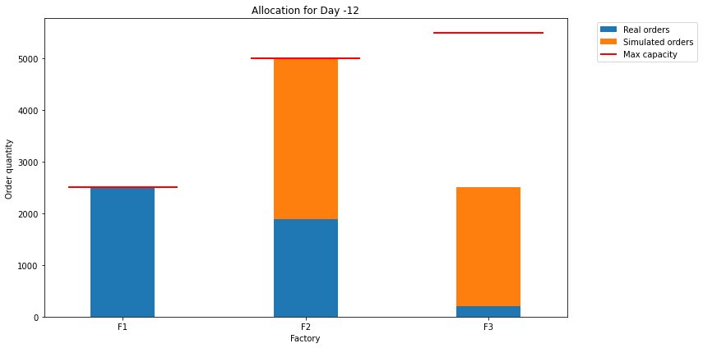
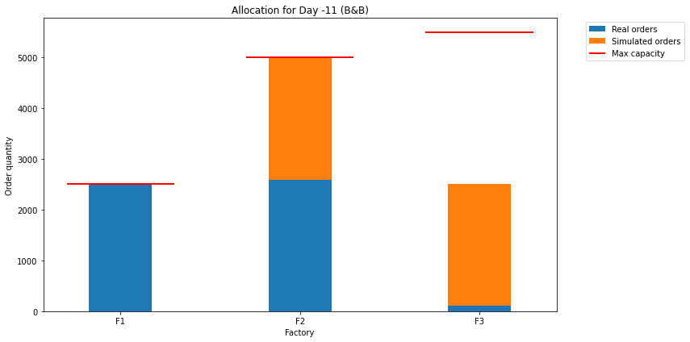

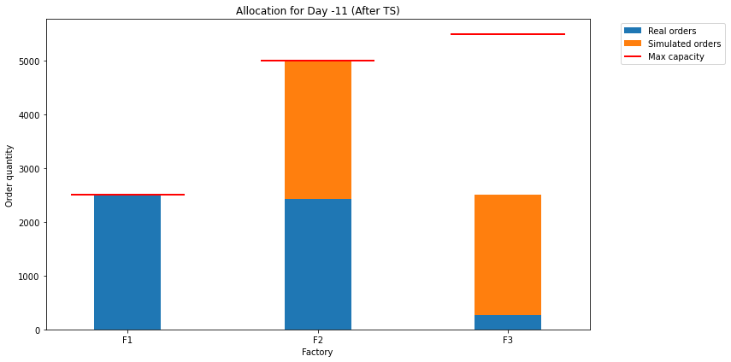
Benchmark test (LD12: 46% real ; LD11: 52% real)
Notes:
I first evaluate the performance of all methods through benchmark test, which just focuses on optimizing the order allocation of LD11 based on LD12.
The above graphs and the exported data in Excel confirm all methods provide solutions satisfying both constraints.

Slide 17
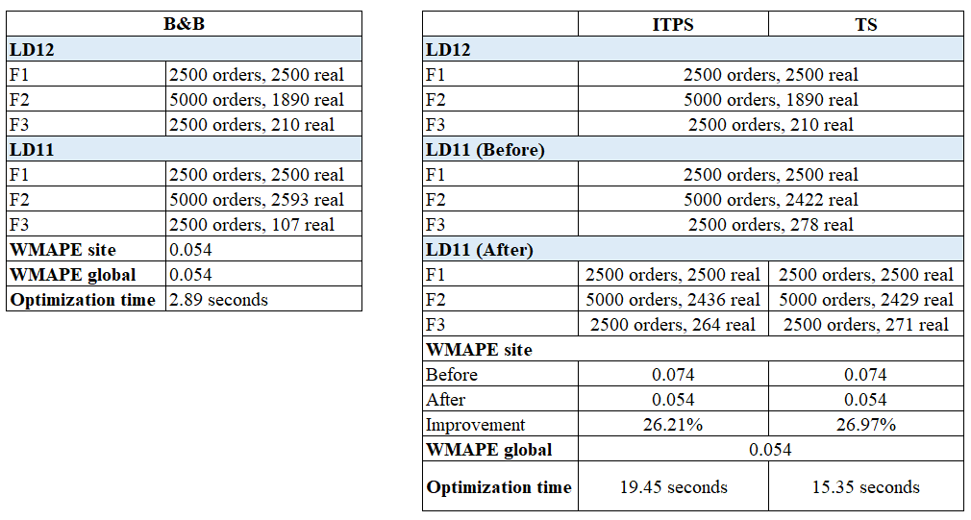
Benchmark test
Notes:
The statistics in the above tables show that B&B provided optimal solutions in the shortest time and is the best method, while TS performed better than ITPS.
Although all methods achieve site error equal or nearly equal to global error, the detailed order breakdown of LD11 highlights the difference in the way 3 methods arrive at the final solutions.

Slide 18
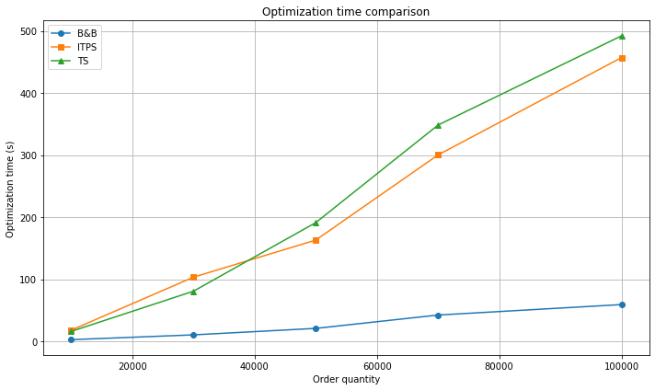
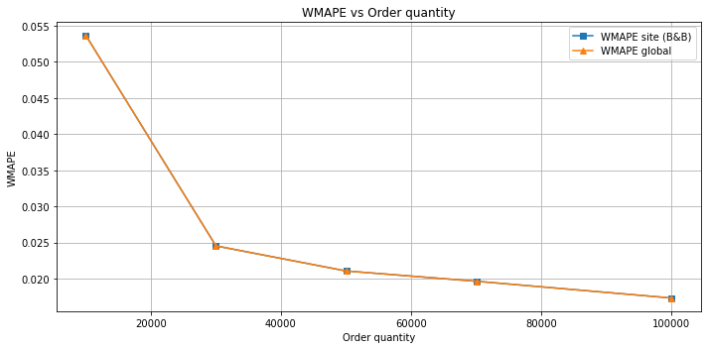
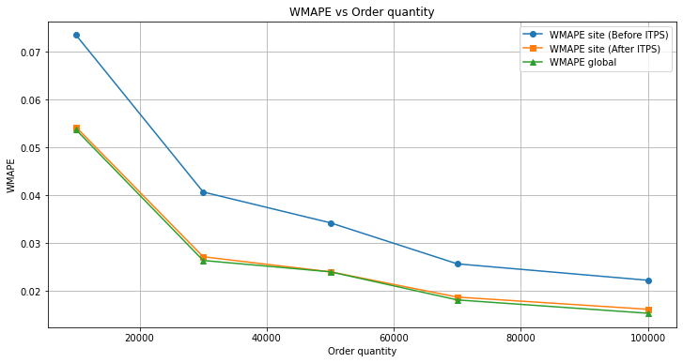
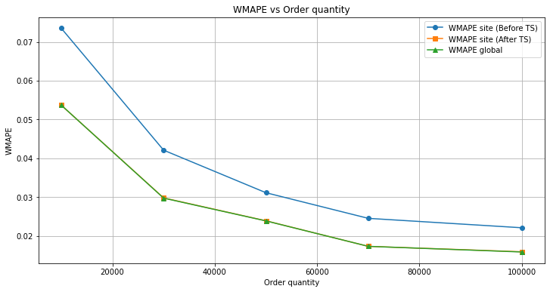
Scalability test
Notes:
The 2nd test is scalability: its goal is to evaluate how each method handles the increasing order quantity.
This test confirms the superiority of B&B in CBC solver when it achieves the optimal solution in the shortest time.
Regarding heuristic, TS which is a more advanced method than ITPS show its potential for BAP when achieving optimal error in less than 10 mins at all order quantities.

Slide 19
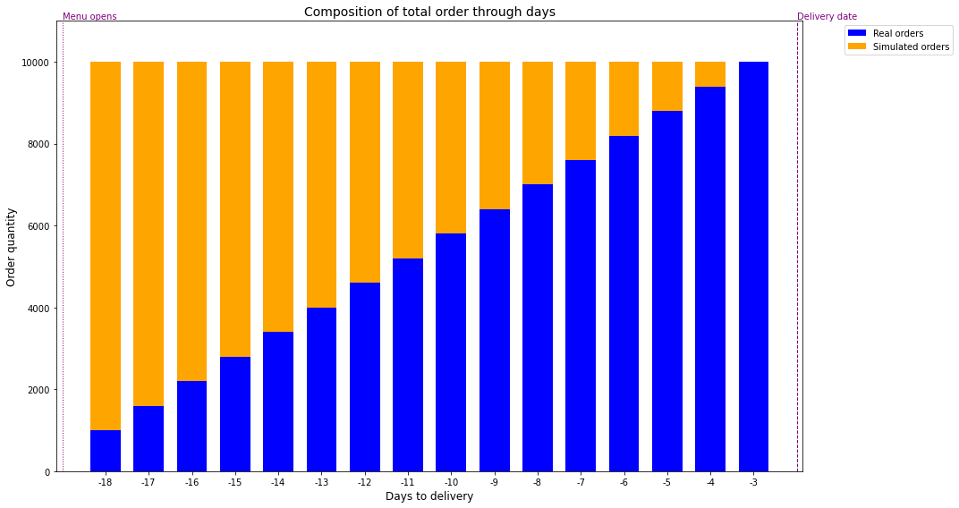
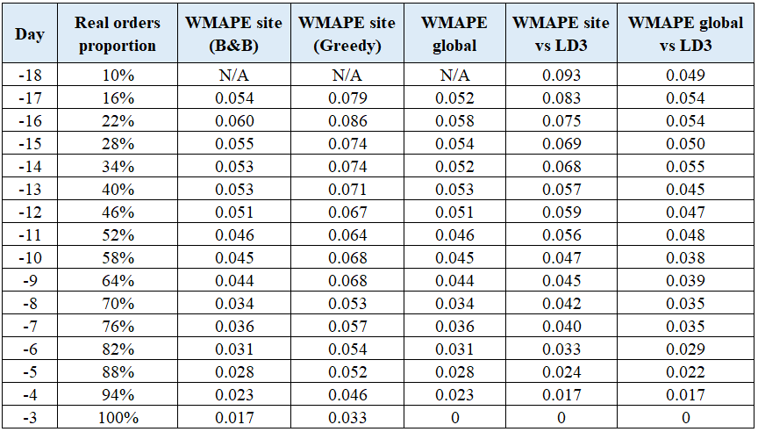
Temporal test - No changes
Notes:
The previous tests are just for two consecutive days. However, our problem requires continuous optimization over the planning period, which necessitates the temporal test.
I first apply the best method – B&B in the ideal condition with no capacity or order changes and gain result as shown on the slide.

Slide 20
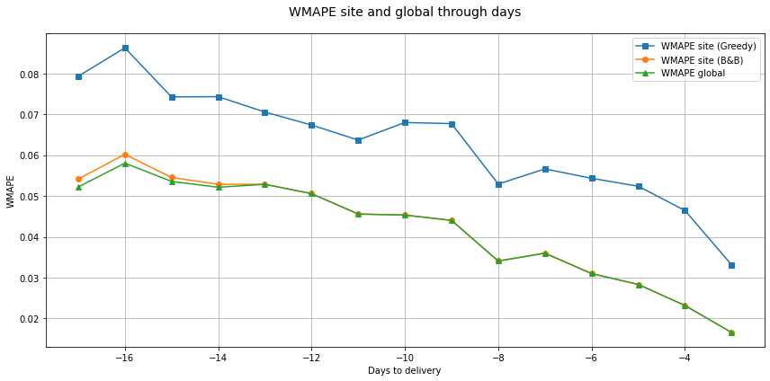
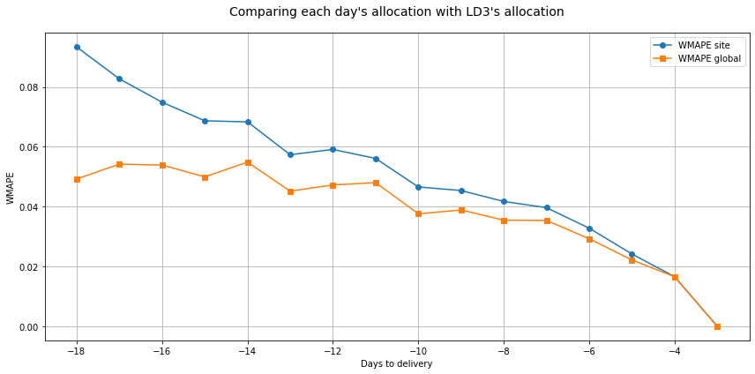
Temporal test - No changes
Errors decrease when order quantity increases (principle of aggregate forecasting)
Notes:
WMAPE data in the previous table is visualized in these line graphs.
The 1st one show the error through days when we optimize the allocation between 2 consecutive days.
It can be seen that when using greedy method, the site error has a big gap with the global error.
In contrast, B&B can provide optimal solution for most days except for the first few days when the proportion of real orders in the total is still low.
At the end of the planning period, the allocation decision of all days are compared with LD3’s allocation to evaluate if CBC solver can help to achieve proxy optimization.
The 2nd graph shows that the area under site error curve is not much larger than the area under global error curve.
The site error line gradually converges with the global error line as we approach LD3.
One note-worthy finding is that errors decreased as the number of orders increased. This can be explained by the principle of aggregate forecasting in SCM.

Slide 21
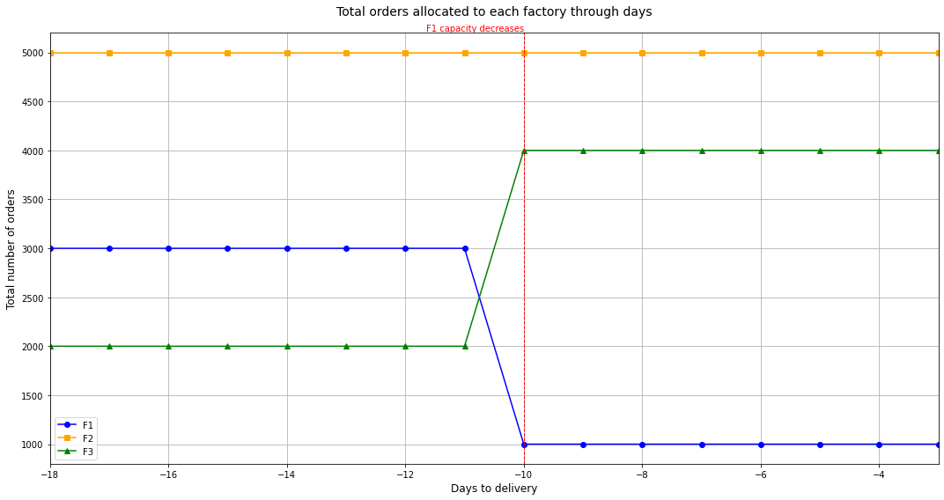
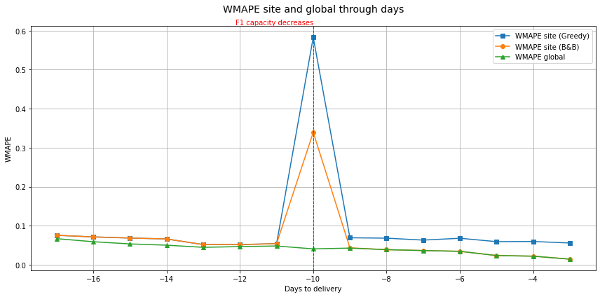
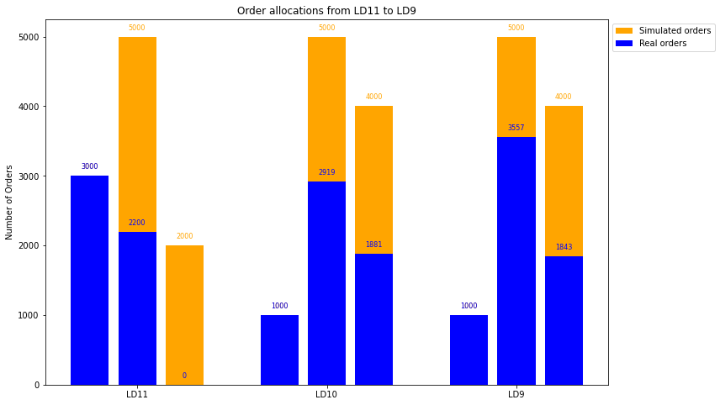
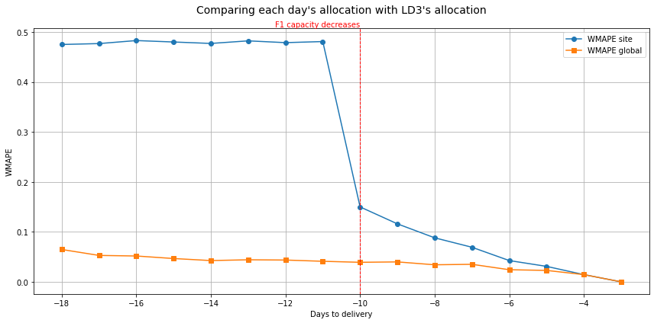
Temporal test - Capacity changes
Notes:
However, many types of changes can happen in reality.
I first investigate the case when F1’s capacity decreases from 3000 to 1000 on LD10 which leads to the order quantity allocated to F3 increases to 4000 as the 1st graph.
The 2nd and 3rd graph show B&B effectiveness in minimizing errors both during and after LD10.
The last bar chart is provided to show how order allocation changes around the capacity reduction point.

Slide 22
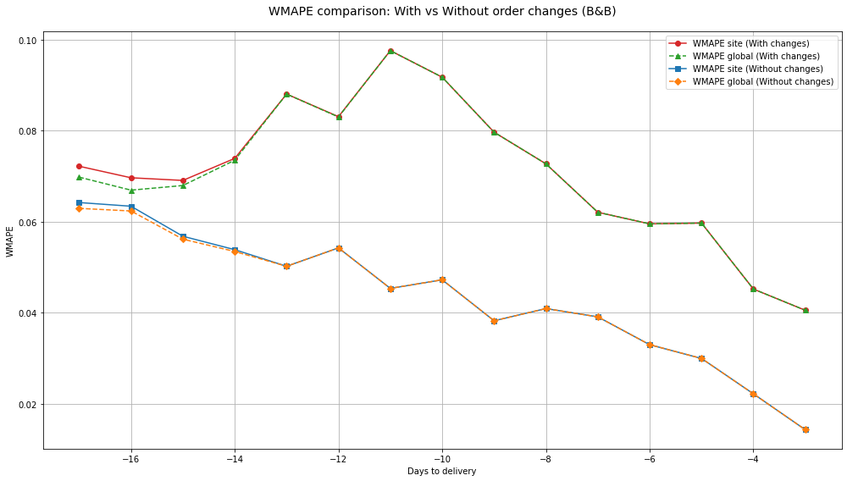
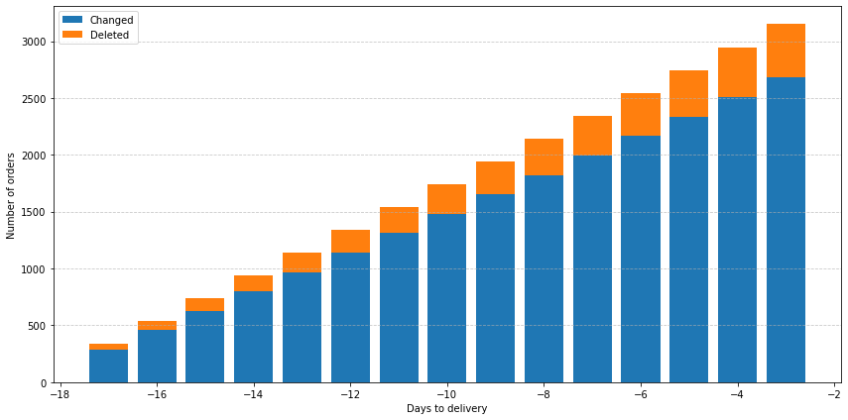
Temporal test - Order changes
Real orders: 5% deleted, 30% changed recipes
Notes:
Besides factory capacity change, there are also order changes, such as recipe changes and order deletions by customers.
I assume everyday, there are 5% of real orders deleted and 30% have recipe changes – a figure higher than reality to highlight the impact of order changes.
The line graph shows that regardless of with or without order changes, B&B can provide optimal solution by matching WMAPE site with WMAPE global.
However, when there are big order changes, the errors will fluctuate significantly and not follow a consistent decreasing trend as when there is no or slight changes.

Slide 23
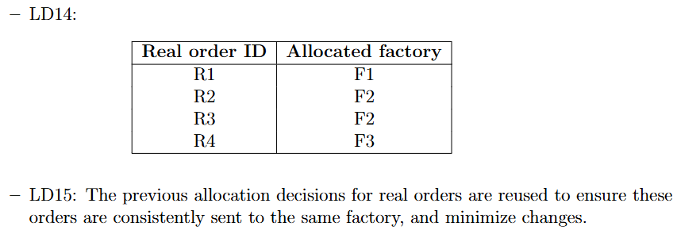
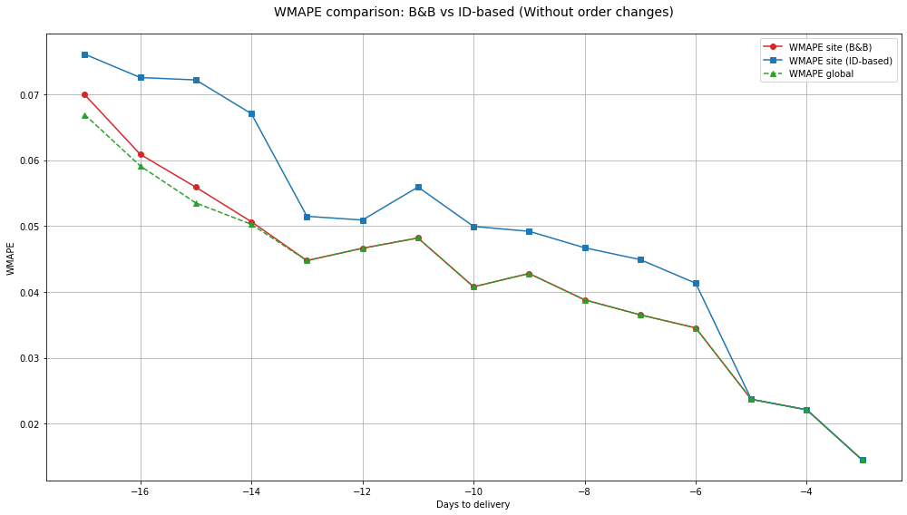
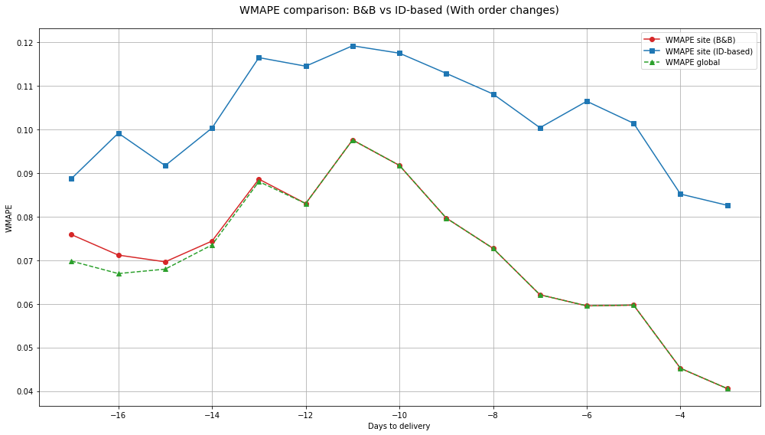
B&B versus ID-based allocation method
Example of ID-based method:
Notes:
In the order change scenario, I also compared the exact method with an ID-based allocation, which assigns orders based on historical IDs as explained on the 1st table.
Two below line graphs showed that B&B outperforms the ID-based method when there are many changes to real orders.

Slide 24
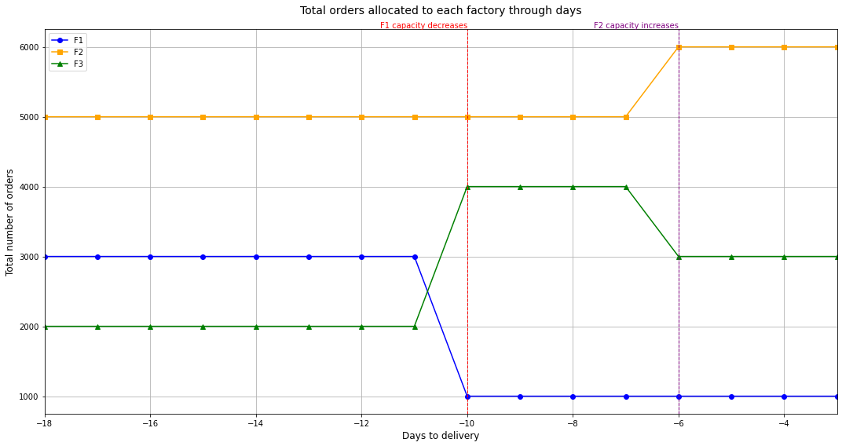
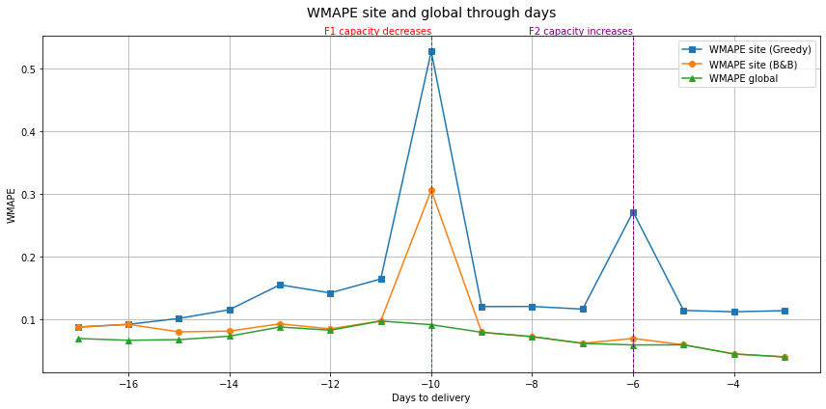
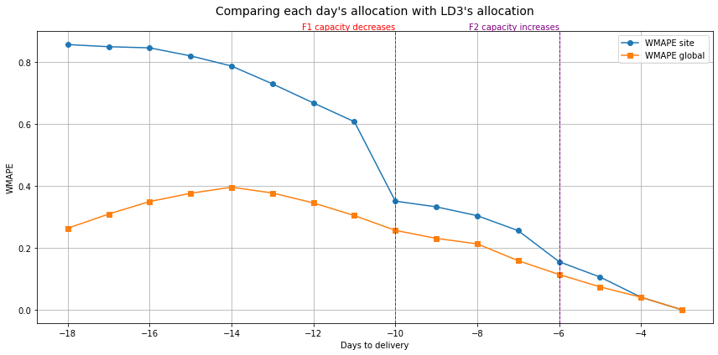
Temporal test - Both capacity and order change
Notes:
In the final temporal test, I simulated both capacity and order changes.
Specifically, F1’s capacity will decrease in LD10 and F2’s capacity will increase in LD6 to see how B&B deals with different kinds of capacity changes.
The results show that B&B could adapt to these dynamic changes effectively, especially when F2’s capacity increases and provide optimal errors on most days.

Slide 25
Contents
Introduction
Methodology
Results and analysis
Limitations and future directions
Notes:
While this project has found potential methods to solve BAP, several limitations remain, opening opportunities for future research.

Slide 26
Limitations and future directions
Limitations:
Use simulated data.
Single-day optimization.
Use single-swap heuristics.
Future work:
Validate with real data.
Investigate approach that consider the entire planning period.
Examine larger moves (LNS, GA,…).
Notes:
Firstly, this dissertation is based on simulated data. Although they match real-world characteristics, future research should apply optimization methods to the real data to validate their
effectiveness in practice
The current model optimizes allocation decisions for each day independently. Future studies could find dynamic optimization approaches that consider the entire planning horizon
simultaneously, potentially leading to better long-term allocation strategies.
While single-swap methods like ITPS and TS have been tested and shown effectiveness, metaheuristics involving larger moves, such as GA or LNS, have not been explored.
Future research could investigate their potential for BAP.

Slide 27

Comments and Questions
Thank You!
Notes:
This is the end of my presentation. Thanks so much for your attention.
I hope you found this presentation insightful. I am happy to answer any questions you may have.

